Slide 1

Chapter 6 The Link Layer
and LANs
Computer Networking: A Top-Down Approach 8th edition Jim Kurose, Keith Ross Pearson, 2020
Acknowledgement: Based on the textbook’s website: https://gaia.cs.umass.edu/kurose_ross/index.php
Notes:
Version History
8.0 (May 2020)
All slides reformatted for 16:9 aspect ratio
All slides updated to 8th edition material
Use of Calibri font, rather that Gill Sans MT
Add LOTS more animation throughout
lighter header font
Updated datacenter slides, day-in-the-life
8.2 (July 2023): changes from 8.0
Minor updates throughout, including removal of master/slave
A few new slides added (transportation analogy, UMass LAN example, extended LANs)
Couple of not-used slides now hidden.

Slide 2

Link layer, LANs: roadmap
introduction
error detection, correction
multiple access protocols
LANs
addressing, ARP
Ethernet
switches
VLANs
link virtualization: MPLS
data center networking
a day in the life of a web request

Slide 3
Multiprotocol label switching (MPLS)
goal: high-speed IP forwarding among network of MPLS-capable routers, using fixed length label (instead of shortest prefix matching)
faster lookup using fixed length identifier
borrowing ideas from Virtual Circuit (VC) approach
but IP datagram still keeps IP address!
Ethernet
header
remainder of Ethernet frame, including IP header with IP source, destination addresses
MPLS header
remainder of Ethernet frame, including IP header with IP source, destination addresses
label
Exp
S
TTL
20
3
1
5

Slide 4
MPLS capable routers
a.k.a. label-switched router
forward packets to outgoing interface based only on label value (don’t inspect IP address)
MPLS forwarding table distinct from IP forwarding tables
flexibility: MPLS forwarding decisions can differ from those of IP
use destination and source addresses to route flows to same destination differently (traffic engineering)
re-route flows quickly if link fails: pre-computed backup paths

Slide 5
MPLS versus IP paths
R6
D
IP router
R4
R3
R5
A
R2
IP routing: path to destination determined by destination address alone

Slide 6
MPLS versus IP paths
IP/MPLS entry router (R4) can use different MPLS routes to A based, e.g., on IP source address or other fields
R6
D
IP router
R4
R3
R5
IP/MPLS router
A
R2
R1
IP routing: path to destination determined by destination address alone
MPLS routing: path to destination can be based on source and destination address
flavor of generalized forwarding (MPLS 10 years earlier)
fast reroute: precompute backup routes in case of link failure

Slide 7
MPLS signaling
modify OSPF, IS-IS link-state flooding protocols to carry info used by MPLS routing:
e.g., link bandwidth, amount of “reserved” link bandwidth
entry MPLS router uses RSVP-TE signaling protocol to set up MPLS forwarding at downstream routers
R6
RSVP-TE
D
R4
R3
R5
modified
link state
flooding
A
R2
R1

Slide 8
MPLS forwarding tables
in out out
label label dest interface
10 A 0
in out out
label label dest interface
12 D 0
8 A 1
10 6 A 1
12 9 D 0
R6
0
0
D
1
1
R4
R3
R5
0
0
A
R2
R1
in out out
label label dest interface
in out out
label label dest interface
8 6 A 0
6 - A 0

Slide 9
Link layer, LANs: roadmap
introduction
error detection, correction
multiple access protocols
LANs
addressing, ARP
Ethernet
switches
VLANs
link virtualization: MPLS
data center networking
a day in the life of a web request

Slide 10

Datacenter networks
10’s to 100’s of thousands of hosts, often closely coupled, in close proximity:
e-business (e.g. Amazon)
content-servers (e.g., YouTube, Akamai, Apple, Microsoft)
search engines, data mining (e.g., Google)
challenges:
multiple applications, each serving massive numbers of clients
reliability
managing/balancing load, avoiding processing, networking, data bottlenecks
Inside a 40-ft Microsoft container, Chicago data center

Slide 11
Datacenter networks: network elements
Border routers
connections outside datacenter
Tier-1 switches
connecting to ~16 T-2s below
Tier-2 switches
connecting to ~16 TORs below
…
…
…
…
Top of Rack (TOR) switch
one per rack
100G-400G Ethernet to blades
…
…
…
…
Server racks
20- 40 server blades: hosts

Slide 12
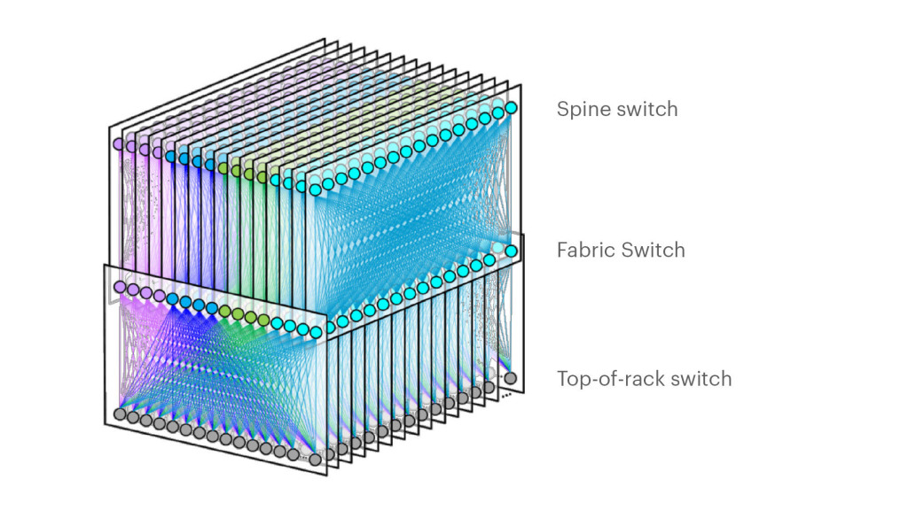
Datacenter networks: network elements
Facebook F16 data center network topology:
https://engineering.fb.com/data-center-engineering/f16-minipack/ (posted 3/2019)

Slide 13
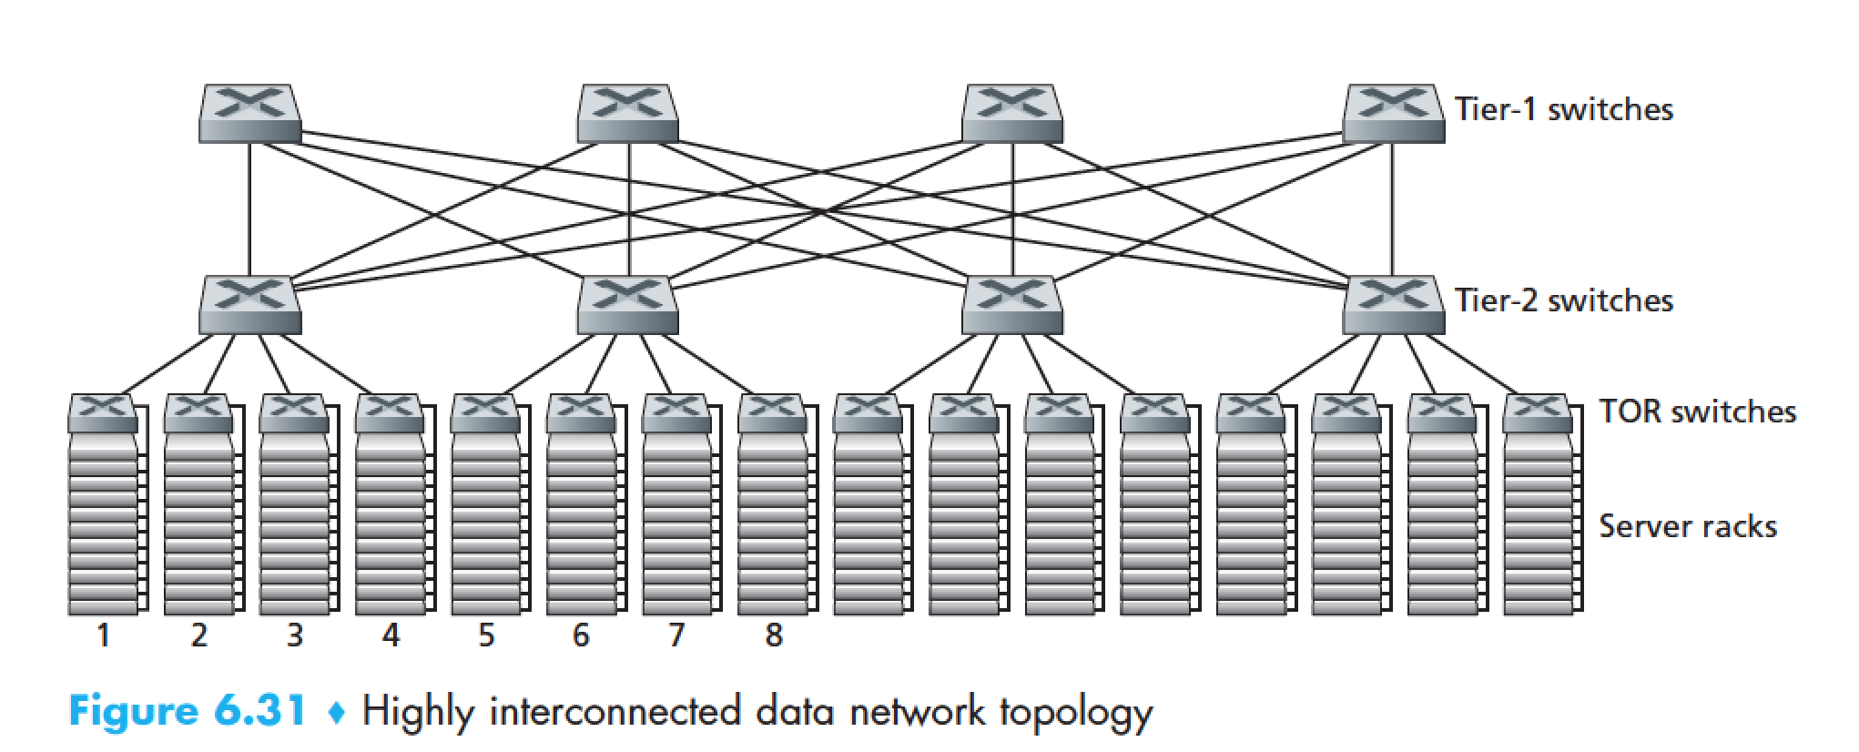
Datacenter networks: multipath
rich interconnection among switches, racks:
increased throughput between racks (multiple routing paths possible)
increased reliability via redundancy
9
10
11
12
13
14
15
16
two disjoint paths highlighted between racks 1 and 11

Slide 14
Datacenter networks: application-layer routing
Internet
load balancer: application-layer routing
receives external client requests
directs workload within data center
Load
balancer
…
…
…
…
returns results to external client (hiding data center internals from client)
…
…
…
…

Slide 15
Datacenter networks: protocol innovations
link layer:
RoCE: remote DMA (RDMA) over Converged Ethernet
transport layer:
ECN (explicit congestion notification) used in transport-layer congestion control (DCTCP, DCQCN)
experimentation with hop-by-hop (backpressure) congestion control
routing, management:
SDN widely used within/among organizations’ datacenters
place related services, data as close as possible (e.g., in same rack or nearby rack) to minimize tier-2, tier-1 communication
Google Networking: Infrastructure and Selected Challenges (Slides: https://networkingchannel.eu/google-networking-infrastructure-and-selected-challenges/

Slide 16
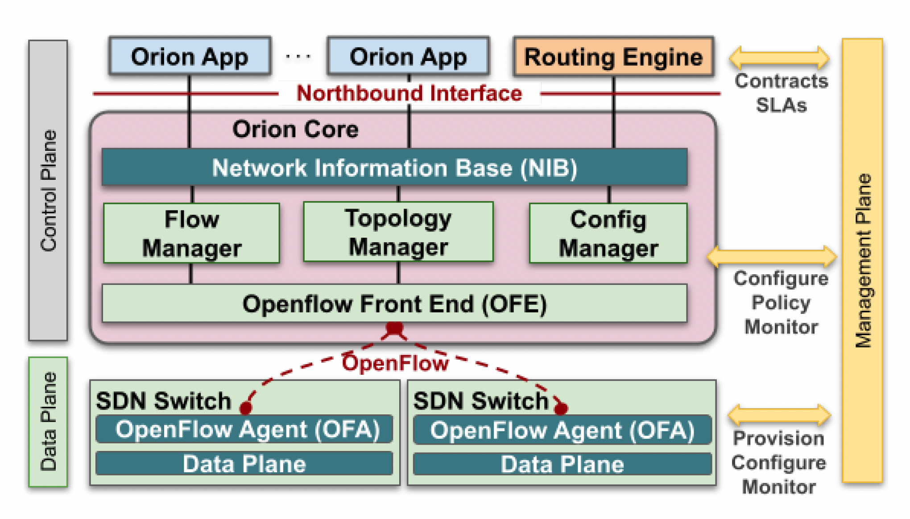
ORION: Google’s new SDN control plane for internal datacenter (Jupiter) + wide area (B4) network
routing (intradomain, iBGP), traffic engineering: implemented in applications on top of ORION core
edge-edge flow-based controls (e.g., CoFlow scheduling) to meet contract SLAs
management: pub-sub distributed microservices in Orion core, OpenFlow for switch signaling/monitoring
Orion SDN architecture and core apps
Note:
no routing protocols, congestion control (partially) also managed by SDN rather than by protocol
are protocols dying?
Notes:
Repeat after each reveal: no protocol
Coflows: “a collection of flows between two groups of machines with associated semantics and a collective objective”; [Sigcomm’13, Sigcomm’15, Sigcomm’18]. Not unlike multiprocessor scheduling in the 1980’s

Slide 17
Link layer, LANs: roadmap
introduction
error detection, correction
multiple access protocols
LANs
addressing, ARP
Ethernet
switches
VLANs
link virtualization: MPLS
data center networking
a day in the life of a web request

Slide 18
Synthesis: a day in the life of a web request
our journey down the protocol stack is now complete!
application, transport, network, link
putting-it-all-together: synthesis!
goal: identify, review, understand protocols (at all layers) involved in seemingly simple scenario: requesting www page
scenario: student attaches laptop to campus network, requests/receives www.google.com

Slide 19
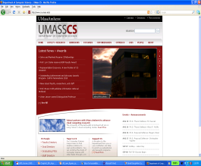




A day in the life: scenario
scenario:
DNS server
arriving mobile client attaches to network …
browser
Comcast network
68.80.0.0/13
requests web page: www.google.com
school network
68.80.2.0/24
web page
Sounds
simple!
web server
Google’s network
64.233.160.0/19
64.233.169.105

Slide 20
A day in the life: connecting to the Internet
DHCP
DHCP
UDP
IP
Eth
Phy
connecting laptop needs to get its own IP address, addr of first-hop router, addr of DNS server: use DHCP
DHCP
DHCP
DHCP
arriving mobile:
DHCP client
DHCP
DHCP request encapsulated in UDP, encapsulated in IP, encapsulated in 802.3 Ethernet
DHCP
DHCP
UDP
IP
Eth
Phy
DHCP
DHCP
DHCP
DHCP
Ethernet frame broadcast (dest: FFFFFFFFFFFF) on LAN, received at router running DHCP server
router has
DHCP server
Ethernet de-muxed to IP de-muxed, UDP de-muxed to DHCP

Slide 21

A day in the life: connecting to the Internet
DHCP
UDP
IP
Eth
Phy
DHCP server formulates DHCP ACK containing client’s IP address, IP address of first-hop router for client, name & IP address of DNS server
DHCP
DHCP
DHCP
arriving mobile:
DHCP client
DHCP
encapsulation at DHCP server, frame forwarded (switch learning) through LAN, demultiplexing at client
DHCP
DHCP
UDP
IP
Eth
Phy
DHCP
DHCP
DHCP
DHCP
router has
DHCP server
DHCP client receives DHCP ACK reply
Client now has IP address, knows name & addr of DNS
server, IP address of its first-hop router

Slide 22
A day in the life… ARP (before DNS, before HTTP)
DNS
DNS
UDP
IP
Eth
Phy
before sending HTTP request, need IP address of www.google.com: DNS
DNS
DNS
ARP
ARP query
arriving mobile:
ARP client
DNS query created, encapsulated in UDP, encapsulated in IP, encapsulated in Eth. To send frame to router, need MAC address of router interface: ARP
ARP
ARP query broadcast, received by router, which replies with ARP reply giving MAC address of router interface
ARP reply
Eth
Phy
router has
ARP server
client now knows MAC address of first hop router, so can now send frame containing DNS query

Slide 23
A day in the life… using DNS
DNS
DNS
DNS
DNS
DNS
DNS
UDP
IP
Eth
Phy
de-muxed to DNS
DNS replies to client with IP address of www.google.com
DNS
DNS
UDP
IP
Eth
Phy
DNS
DNS
DNS
DNS
DNS
DNS
server
DNS
DNS
Comcast network
68.80.0.0/13
IP datagram containing DNS query forwarded via LAN switch from client to 1st hop router
IP datagram forwarded from campus network into Comcast network, routed (tables created by RIP, OSPF, IS-IS and/or BGP routing protocols) to DNS server

Slide 24
A day in the life…TCP connection carrying HTTP
DNS
DNS
DNS
HTTP
HTTP
TCP
IP
Eth
Phy
to send HTTP request, client first opens TCP socket to web server
SYNACK
SYN
SYNACK
SYN
SYNACK
SYN
SYN
Comcast network
68.80.0.0/13
TCP SYN segment (step 1 in TCP 3-way handshake) inter-domain routed to web server
TCP
IP
Eth
Phy
web server responds with TCP SYNACK (step 2 in TCP 3-way handshake)
SYNACK
SYN
SYNACK
SYN
SYNACK
SYNACK
SYN
TCP connection established!
Google web server
64.233.169.105

Slide 25
A day in the life… HTTP request/reply
DNS
DNS
DNS
HTTP
HTTP
TCP
IP
Eth
Phy
HTTP request sent into TCP socket
HTTP
HTTP
HTTP
web page finally (!!!) displayed
HTTP
HTTP
HTTP
HTTP
HTTP
IP datagram containing HTTP request routed to www.google.com
Comcast network
68.80.0.0/13
web server responds with HTTP reply (containing web page)
HTTP
HTTP
TCP
IP
Eth
Phy
HTTP
HTTP
HTTP
HTTP
IP datagram containing HTTP reply routed back to client
Google web server
64.233.169.105

Slide 26
Chapter 6: Summary
principles behind data link layer services:
error detection, correction
sharing a broadcast channel: multiple access
link layer addressing
instantiation, implementation of various link layer technologies
Ethernet
switched LANS, VLANs
virtualized networks as a link layer: MPLS
synthesis: a day in the life of a web request

Slide 27
Chapter 6: let’s take a breath
journey down protocol stack complete (except PHY)
solid understanding of networking principles, practice!
….. could stop here …. but more interesting topics!
wireless
security

